Slide 1
SWVL
Creativity out of bounds

Slide 2





Ahmed Saed
Adham Essam
Mohamed Sherbiny
Mazin Mohamed
Mahmoud Kolib
Notes:
Who are we?

Slide 3
Table of Content
What is SWVL?
What’s unique about SWVL?
How does SWVL operate?
Database & Entity Relation Diagram

Slide 4
What is SWVL?
Swvl was co-founded in Egypt in April 2017 by Mostafa Kandil. Swvl began developing an app to address traffic congestion in Cairo, but then switched to developing it as a platform for booking cheap bus trips in the city.
Swvl provides ride-hailing services with a focus on mass transit. The company’s proprietary algorithm uses the passenger’s location and destination to calculate the quickest trip time. The technology also allows for more efficiency than public transportation, which results in lower emissions. (Swvl claims it has prevented over 240 million pounds of carbon emission since inception)

Slide 5
What’s unique about SWVL?
Picking the most convenient routes SWVL provides users with the most convenient routes for them in terms of time and distance.
Easy payment; users pay for SWVL through a simple click on the app.
Tracking SWVL bus trips through the app; users can view and track SWVL buses in real-time.
High Quality meets Low Prices SWVL provides comfortable seats and transportation conditions at 50% to 80% cheaper prices than the rest of on-demand services.

Slide 6
How does SWVL operate?
It was important to generate demand with the lowest possible budget. By combining the power of Google Analytics with Big Query, Data Studio and Firebase, the team made intelligent use of digital information to get the very best performance out of every ad.
SWVL segmented the audience by demographic, location and operating system in order to drive the highest conversion rates with the lowest cost. SWVL’s targeting quality then helped the team optimize the cost of in-app actions.
SWVL’s strategy has enabled the startup to achieve a 90% growth in customer acquisition with higher quality of sales.

Slide 7
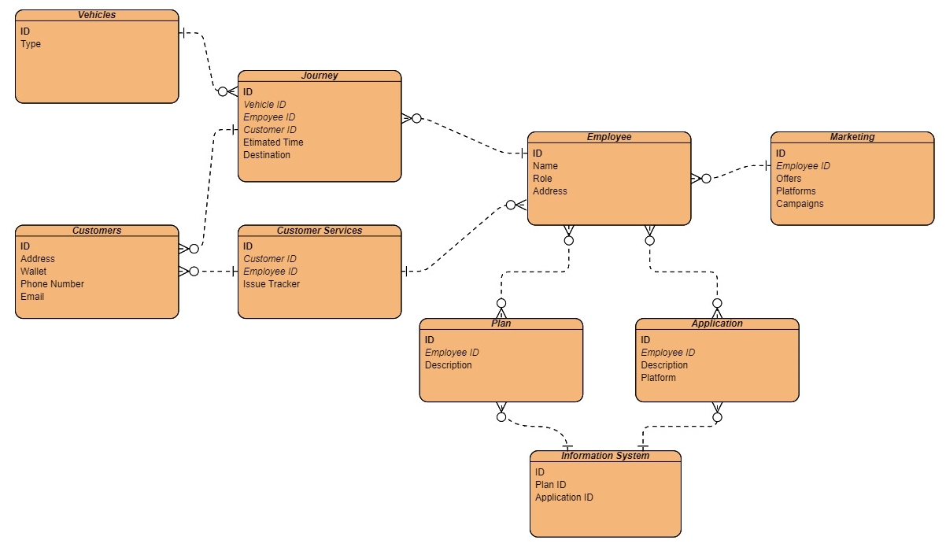
Entity Relation Diagram

Slide 8
Thanks ❤️

Slide 9
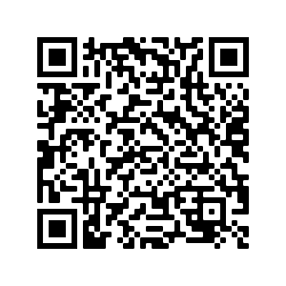
Try Swvl from this link and you will get 50 L.E. free credit.

